Slide 1


Capstone Project
Rent A Place
Batch No : C4
Group : G13
Presentation by:
Shivesh Pratap Mall
Tharun Karanam
Ajay Ganapathi Viswanadha Raju Gunturi
Tutike Naga Venkata Siva Sai Pratap
Mouli Palla
Under the Esteemed Guidance of :
Mr. Shadab Ahmad Khan

Slide 2
Functional Requirements:
User Stories:
As a user I should be able to login, Logout and Register into the application.
As a user I should be able to see the top-rated properties in different categories.
As a user I should be able to search property as per the different search criteria’s as: -
a. Check-in and check-out date
b. Place to visit
c. Type of property like (flat, apartment, villas)
d. Features like pool, pool facing, beach, beach facing, garden, garden facing and many more
As a user I should be able to see the selected properties in list or card view.
As a user I should be able to see 4 to 5 pics Of each property.
As a user I should be able to reserve the property.
As a user I should be able to send message on the application to the owner.

Slide 3
Functional Requirements:
Owner Stories:
As an Owner I should be able to login, Logout and Register into the application.
As an Owner I should be able to add properties on the platform. Properties can be more than one.
As an owner I should be able to update, delete and get the properties.
As an owner I should be able to see the messages of the users.
As an owner I should be able to reply on the messages.
As an owner I should be able to get mail as soon as the user reserved a property.
As an owner I should be able to conform to the reserved status.

Slide 4
Functionality Of User:
Functionality Of Owner:
Register
Register
Login
Login
Search
Add Property
Update Property
User
Reserve Property
Owner
Delete Property
Messaging
Conform Booking
Email
Messaging
Logout
Logout

Slide 5
Technical Requirements:
Technologies: Angular, Springboot, MySQL
Languages: Typescript, Java, SQL queries
IDE: Eclipse for Enterprise, VS Code
HTML, CSS
MySQL Workbench

Slide 6
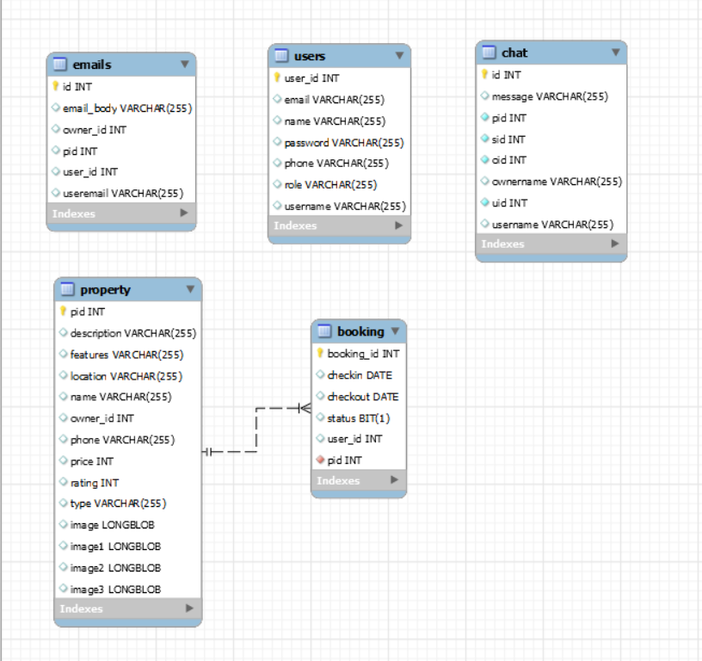
Database Schema

Slide 7
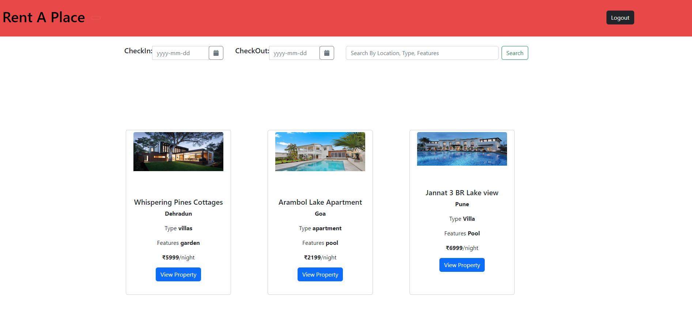
Home Page

Slide 8
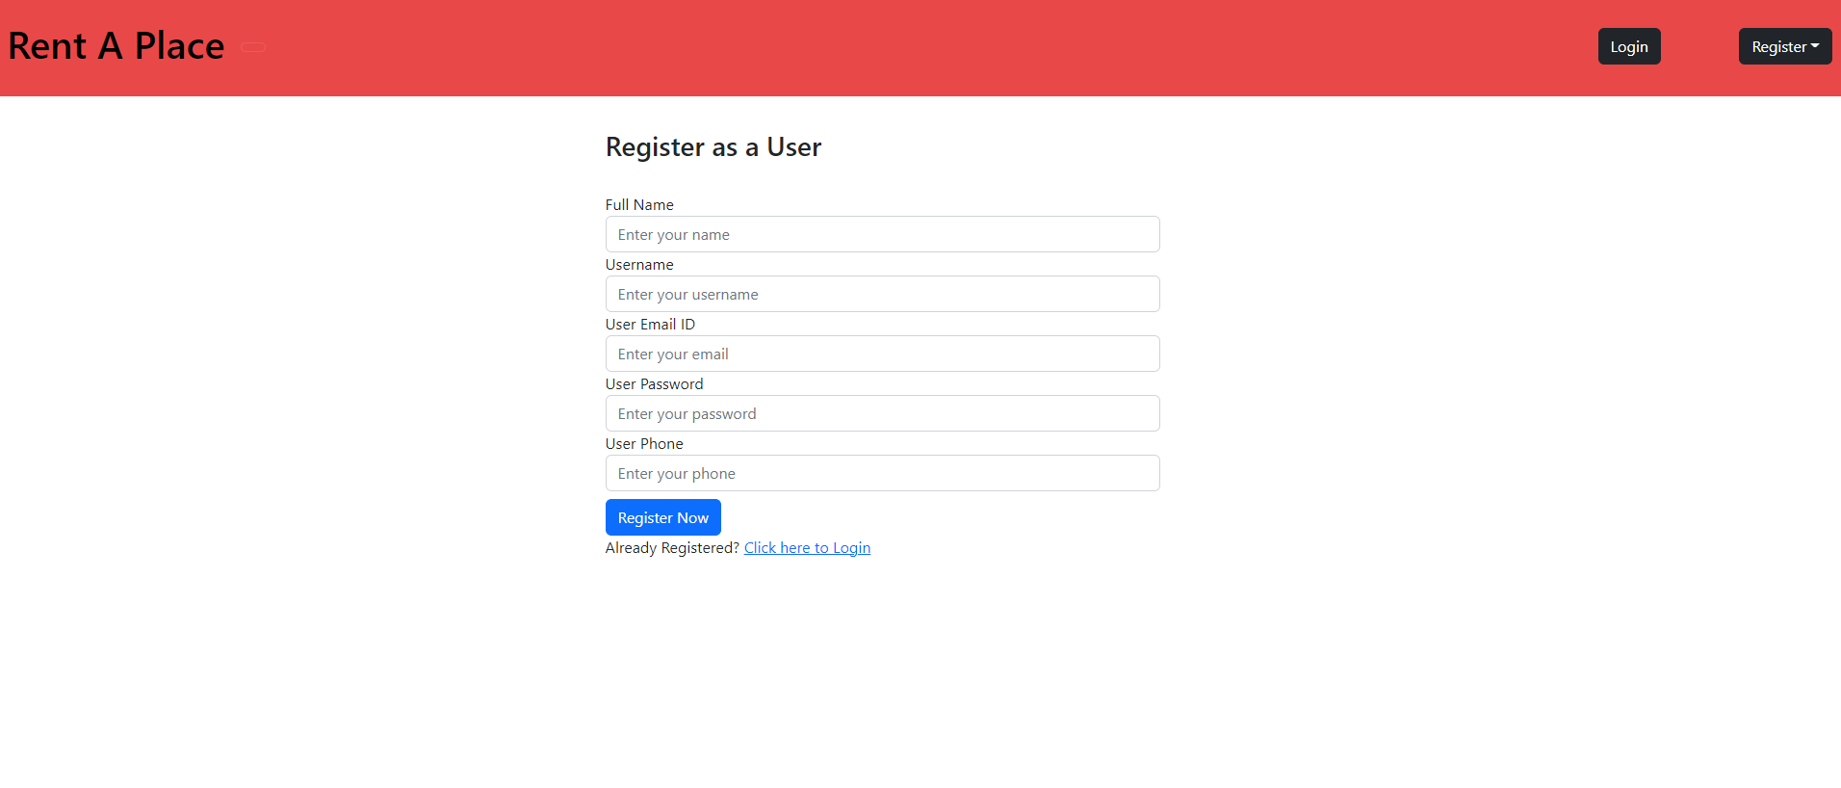
User Registration Form

Slide 9
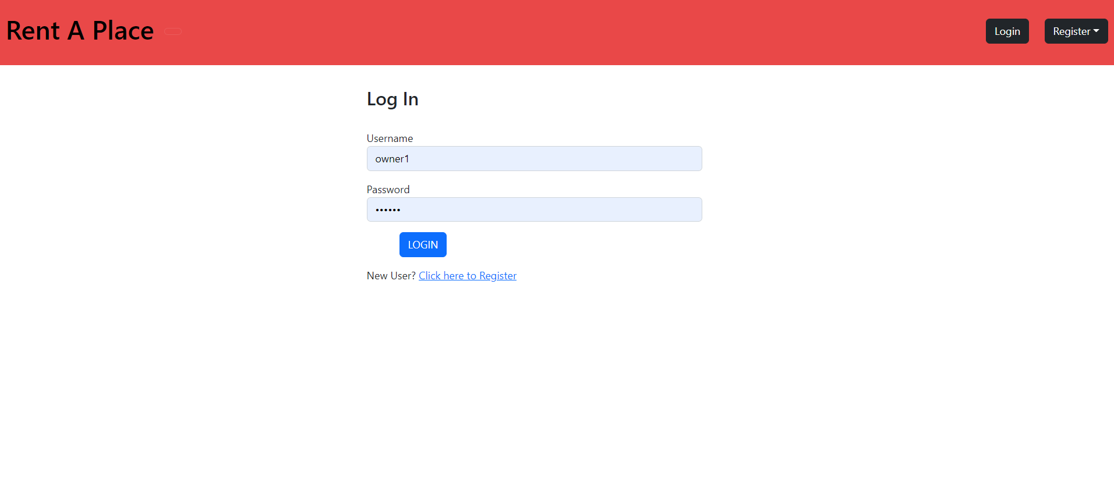
Login Page

Slide 10
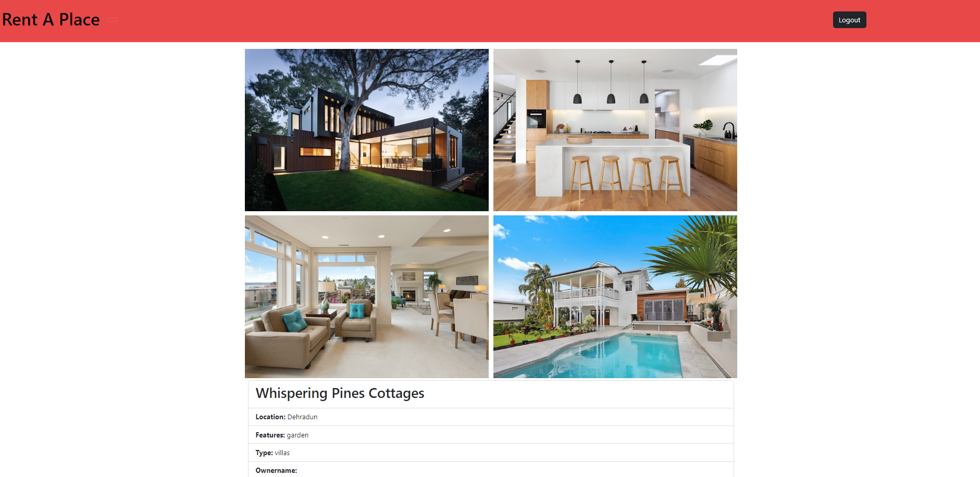
Property View

Slide 11
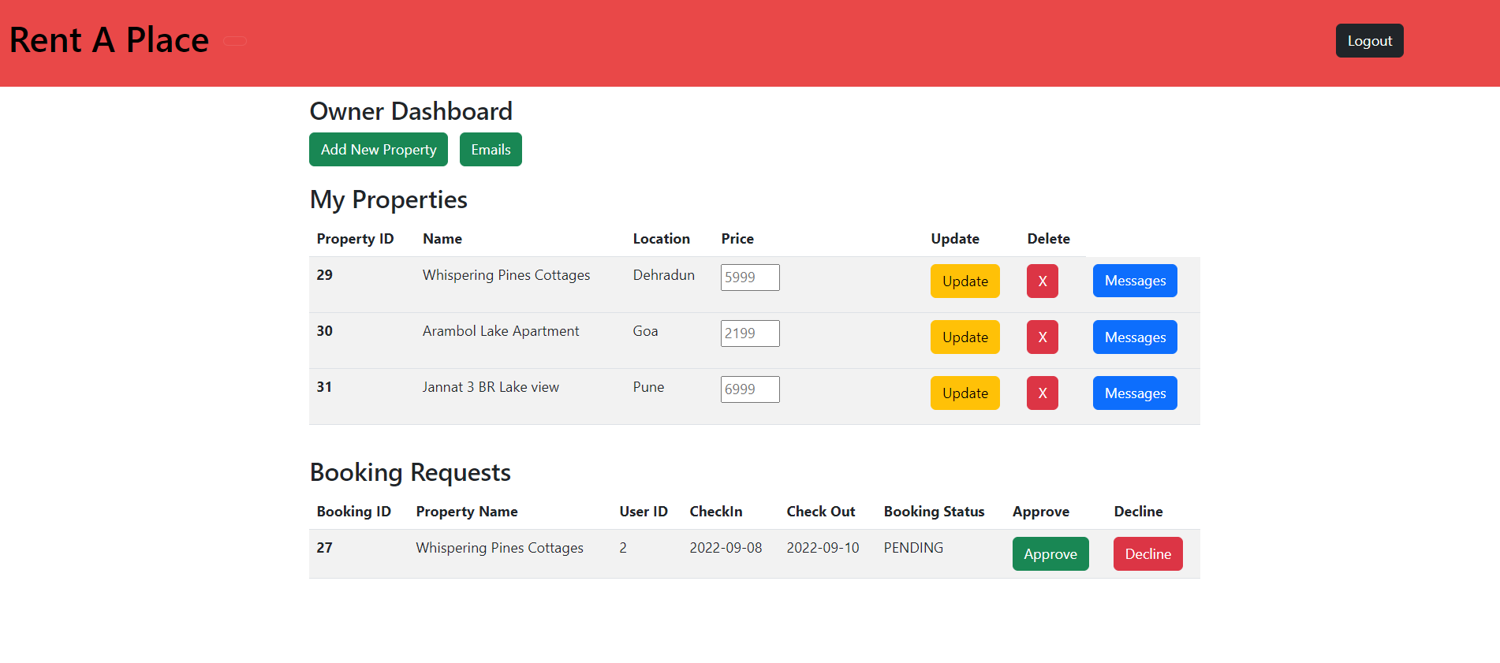
Owner Dashboard

Slide 12
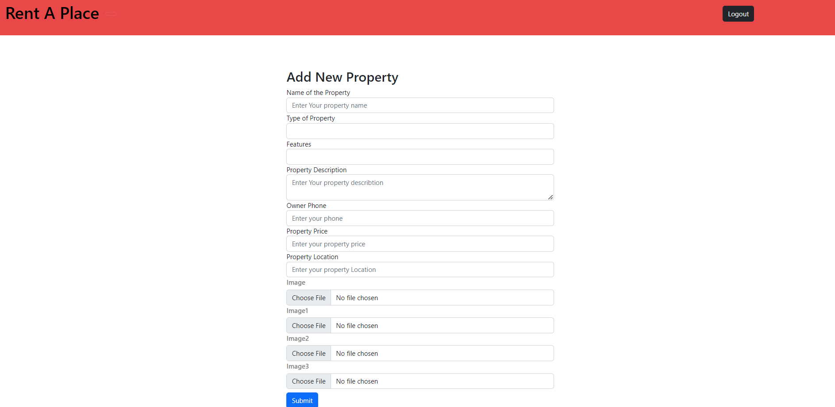
Add New Property

Slide 13
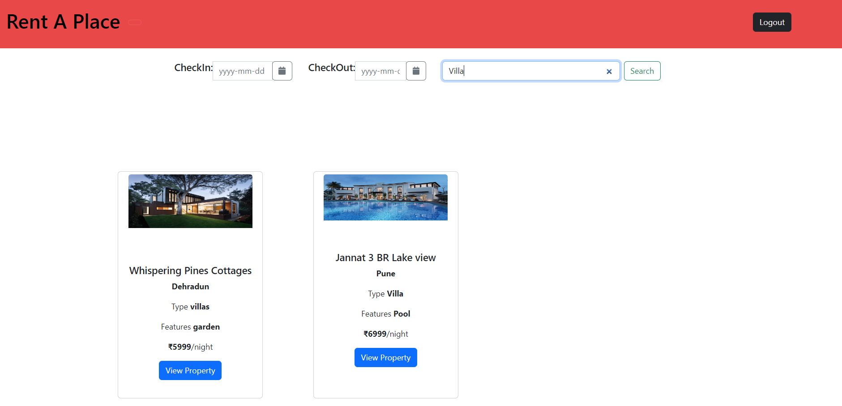
Property Search

Slide 14
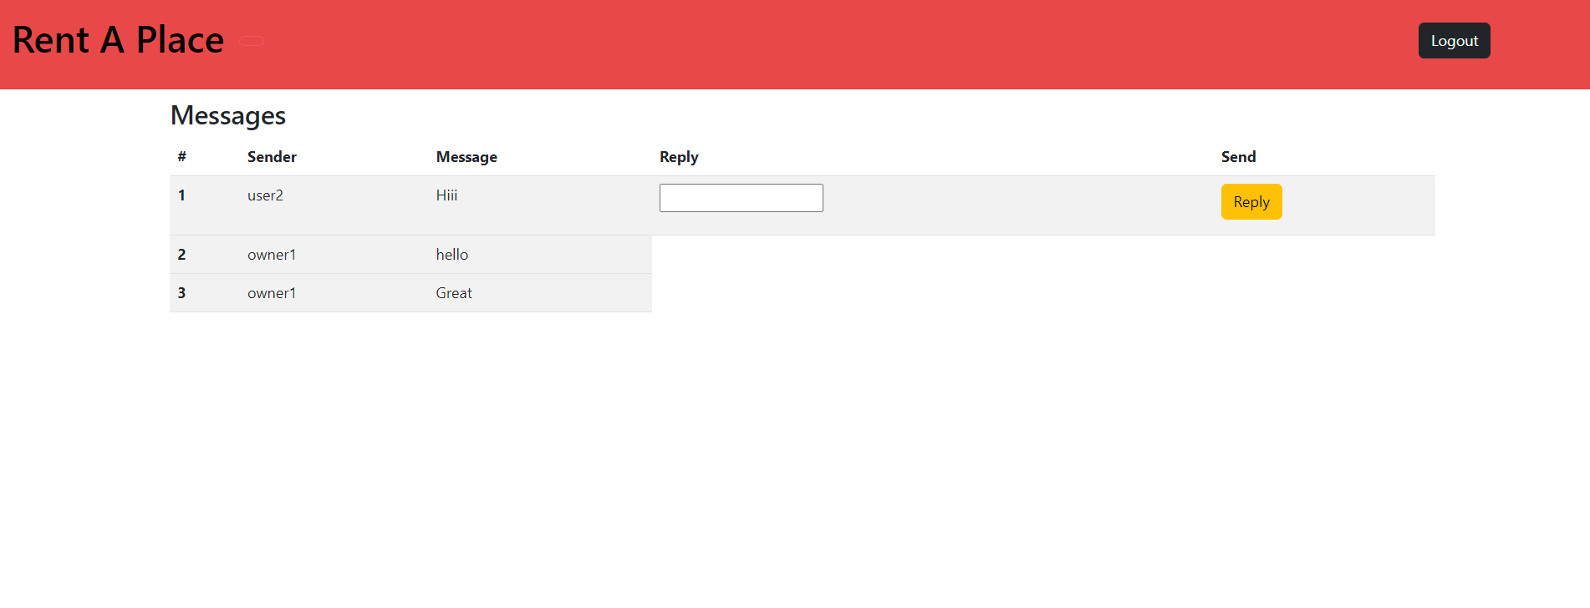
Owner Messaging

Slide 15
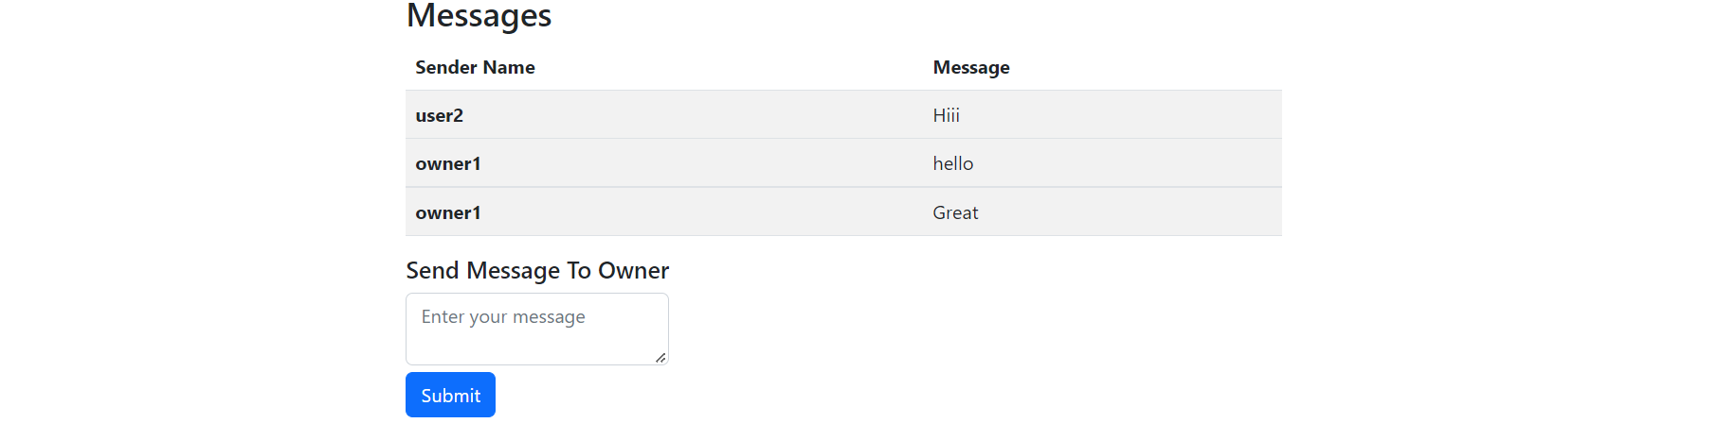
User Messaging

Slide 16
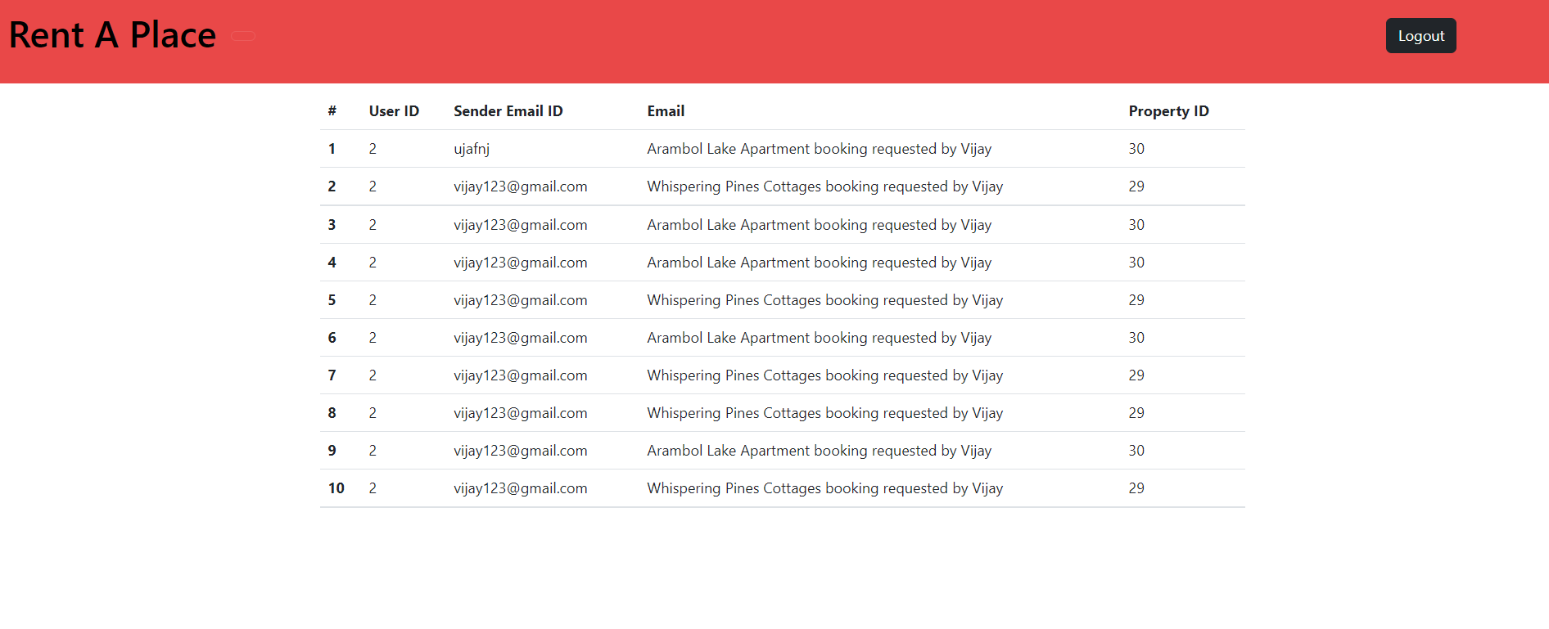
Email

Slide 17
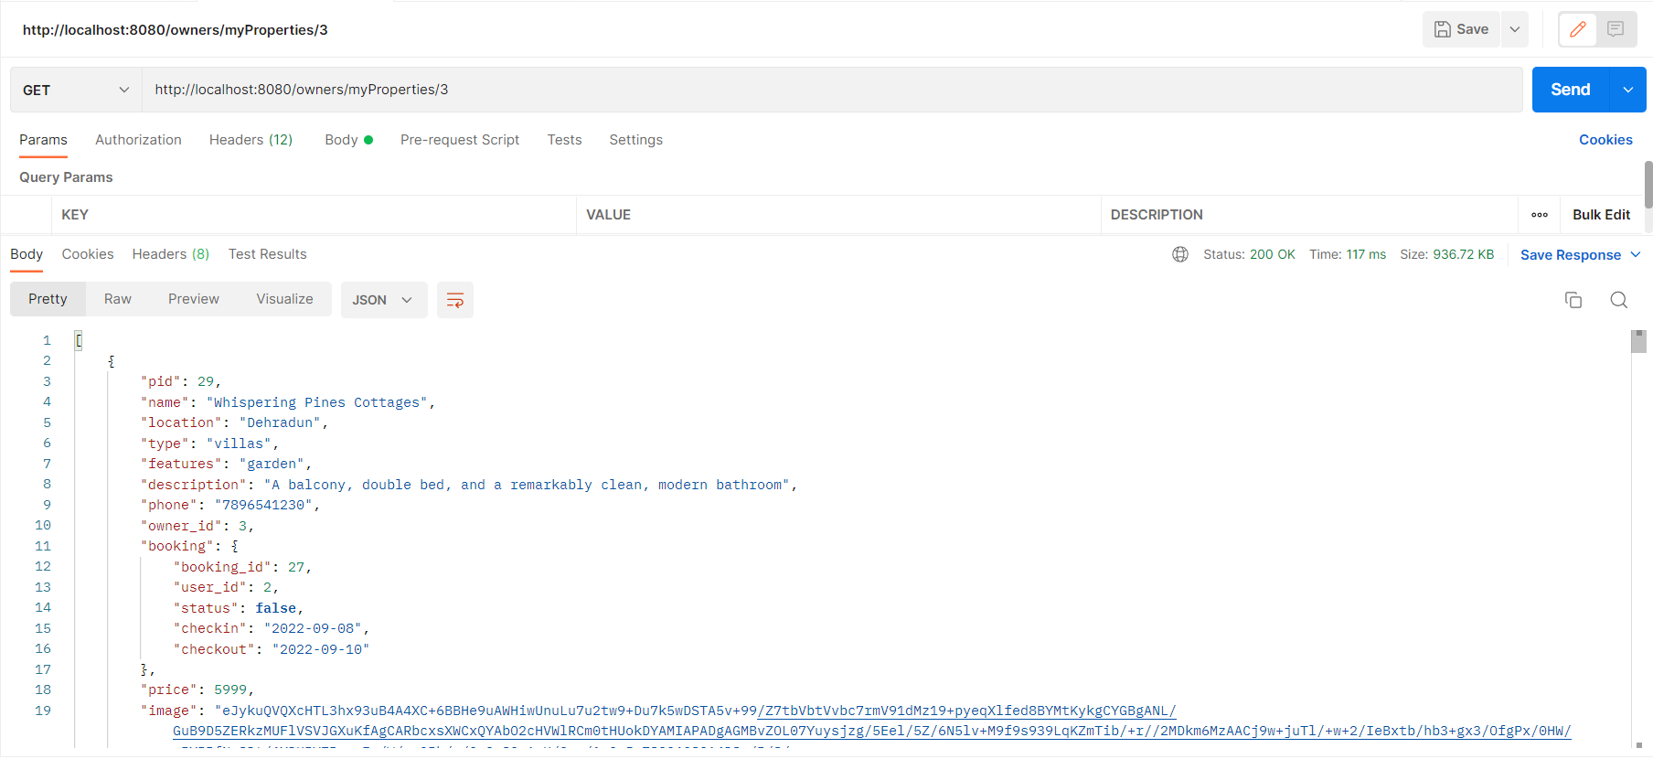
Backend API Call: Get Properties of Owner

Slide 18
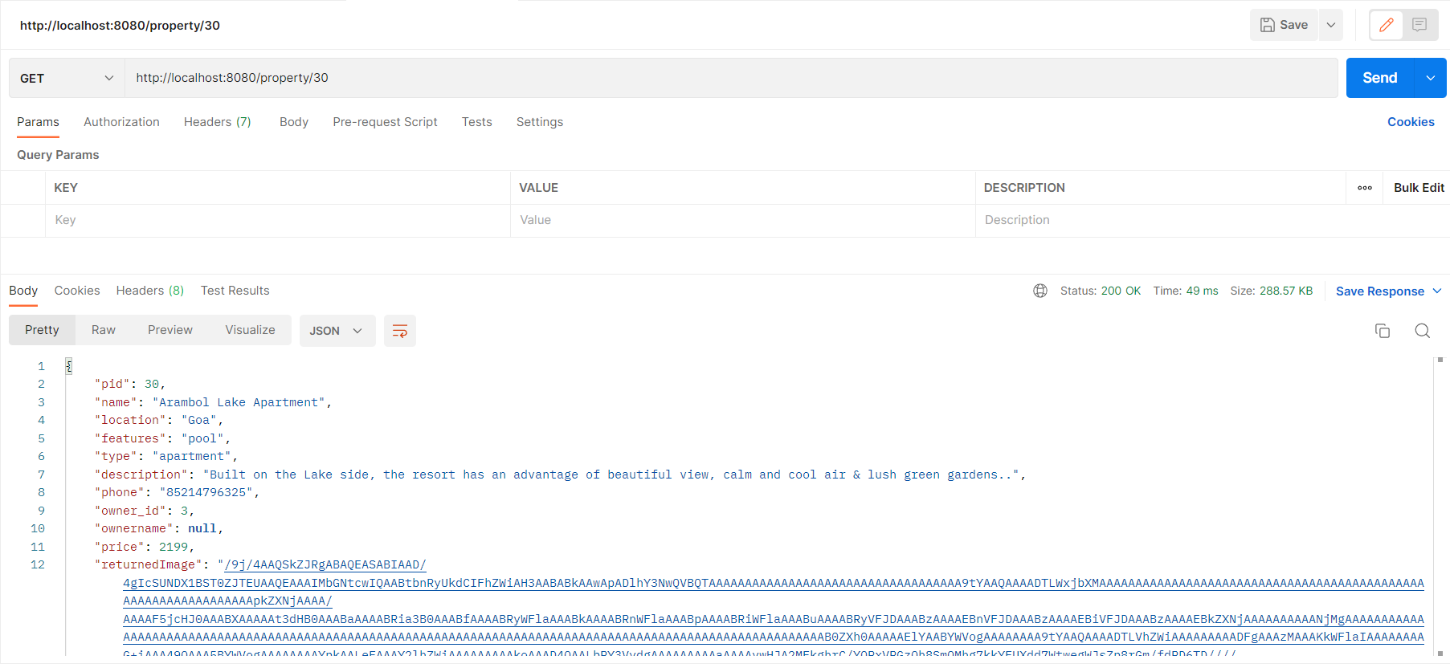
Backend API Call: Get Property by PID

Slide 19
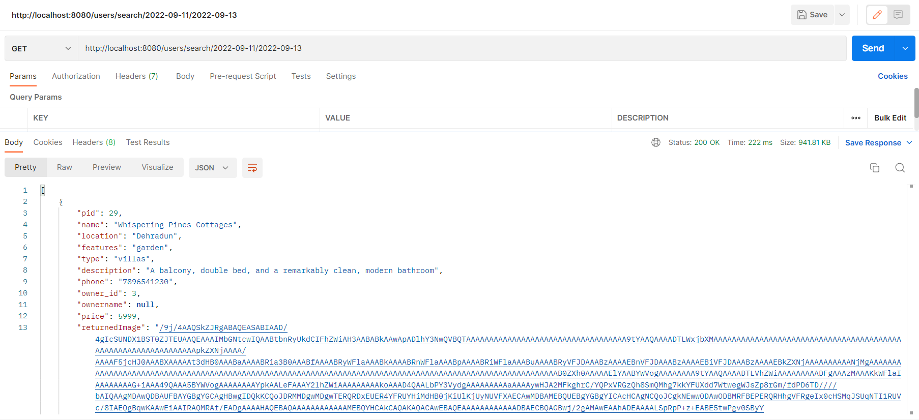
Backend API Call : Search based on Check-in & Check-out Date

Slide 20
Conclusion:
We conclude that we have created a Rent A Place application successfully with all the requirements mentioned in the given problem statement and we have successfully deployed our project in the Angular and Spring Boot.

Slide 21


